Slide 1
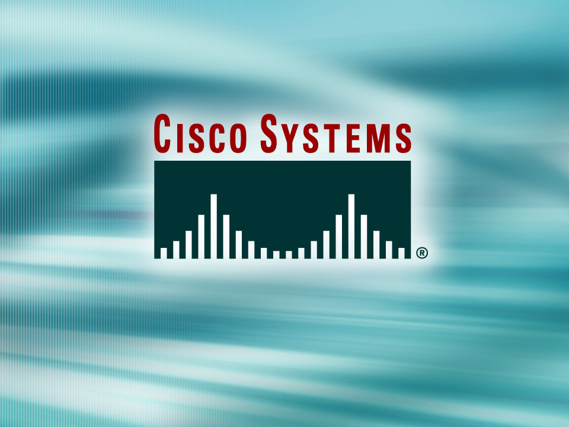
© 2002, Cisco Systems, Inc. All rights reserved.

Slide 2
Configuring Catalyst Switch Operations
Module 3
Notes:
Purpose: This chapter introduces the Cisco IOS™ CLI on the Catalyst® 1900 switch and router.
Timing: This chapter should take about 2 hours to present.
Note: The Catalyst 1900 switch only has a subset of the router Cisco IOS commands available.
Contents:
Introduction to Cisco IOS. Explain to the student what is IOS?
Cisco Device startup procedures in general.
IOS configuration source.
General introduction to the IOS CLI.
Cat 1900 switch startup procedures.
Intro to Cat 1900 CLI. This part covers the basic configuration on the switch, like setting the IP address and hostname. More details about the various Cat 1900 switch configuration commands are explained in Chapter 6 and 7.
Router startup procedures. More details on the router startup process is discussed in chapter 5.
Router IOS CLI.

Slide 3
Objectives
Upon completing this module, you will be able to:
  Explain how bridging and switching operates
  Explain the purpose and operations of the Spanning-Tree Protocol
  Verify the default configuration of the device, given a functioning access layer switch
  Build a functional access switch configuration to support the specified network operational parameters, given a network design
  Execute an add, move, or change on an access layer switch, given a new network requirement
Notes:
Slide 1 of 2
Purpose: This slide states the chapter objectives.
Emphasize: Read or state each objective so that each student has a clear understanding of the chapter objectives.
Note: Catalyst switches have different CLIs. The Catalyst 2900xl and the Catalyst 1900 has a Cisco IOS CLI. The Cisco IOS CLI commands available on the 2900xl is different from the 1900. The Catalyst 5000 family has no Cisco IOS CLI, and use the set commands instead. This class only covers the configuration on the Catalyst 1900 switch.

Slide 4

Basic Layer 2 Switching and Bridging Functions
© 2002, Cisco Systems, Inc. All rights reserved.
Notes:
Purpose: This chapter introduces the Cisco IOS™ CLI on the Catalyst® 1900 switch and router.
Timing: This chapter should take about 2 hours to present.
Note: The Catalyst 1900 switch only has a subset of the router Cisco IOS commands available.
Contents:
Introduction to Cisco IOS. Explain to the student what is IOS?
Cisco Device startup procedures in general.
IOS configuration source.
General introduction to the IOS CLI.
Cat 1900 switch startup procedures.
Intro to Cat 1900 CLI. This part covers the basic configuration on the switch, like setting the IP address and hostname. More details about the various Cat 1900 switch configuration commands are explained in Chapter 6 and 7.
Router startup procedures. More details on the router startup process is discussed in chapter 5.
Router IOS CLI.

Slide 5
Objectives
Upon completing this lesson, you will be able to:
  Describe Layer 2 switching and bridging operations and modes
  Describe how LAN switches use and populate the MAC address table
Notes:
Slide 1 of 2
Purpose: This slide states the chapter objectives.
Emphasize: Read or state each objective so that each student has a clear understanding of the chapter objectives.
Note: Catalyst switches have different CLIs. The Catalyst 2900xl and the Catalyst 1900 has a Cisco IOS CLI. The Cisco IOS CLI commands available on the 2900xl is different from the 1900. The Catalyst 5000 family has no Cisco IOS CLI, and use the set commands instead. This class only covers the configuration on the Catalyst 1900 switch.

Slide 6
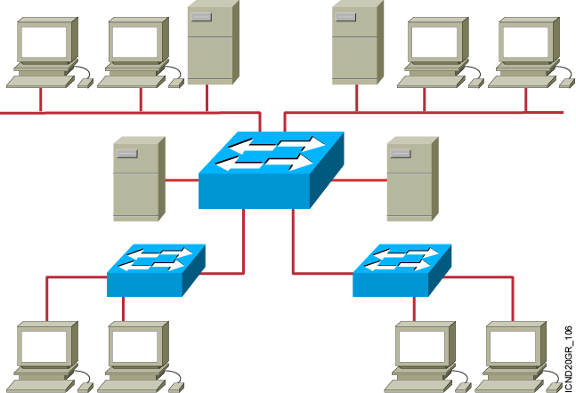
Ethernet Switches and Bridges
  Address learning
  Forward/filter decision
  Loop avoidance
Notes:
Emphasize: The next few slides discuss the basic function of a bridge/switch:
1. How it learns the location of the hosts by reading the source MAC address of incoming frames.
2. How it makes forwarding/filtering decisions.
There are three conditions in which a switch will flood a frame out on all ports except to the port on which the frame came in, as follows:
Unknown unicast address
Broadcast frame
Multicast frame
3. How STP is used to avoid loops in a switched/bridged network.

Slide 7
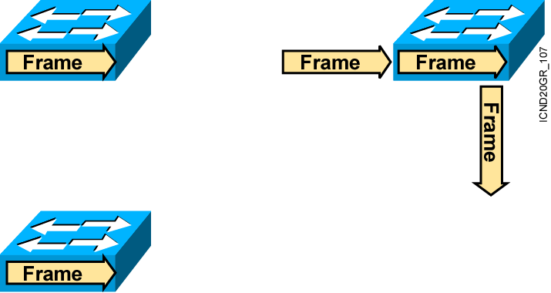
Transmitting Frames
Cut-Through
  Switch checks destination address and immediately begins forwarding frame.
Store and Forward
  Complete frame is received and checked before forwarding.
Fragment-Free
  Switch checks the first 64 bytes, then immediately
  begins forwarding frame.
Notes:
Layer 3 of 3
Note: 64 bytes is the minimum Ethernet frame size.
The command to switch the mode on the 1900 is:
wg_sw_a(config)#switching-mode ?
fragment-free Fragment Free mode
store-and-forward Store-and-Forward mode

Slide 8
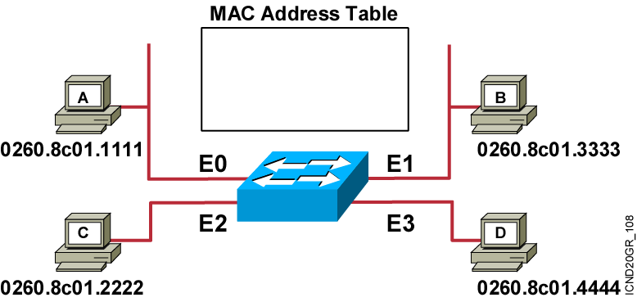
MAC Address Table
Initial MAC address table is empty.
Notes:
Slide 1 of 3
Emphasize: The 1900en max MAC address table size is 1024. Once the table is full, it will flood all new addresses until existing entries age out.
The command to change the MAC address table aging time is, as follows:
wg_sw_a(config)#mac-address-table aging-time ?
<10-1000000> Aging time value
The default is 300 sec.
The MAC address table is also referred to as the CAM table (Content Address Memory) on some switches.

Slide 9
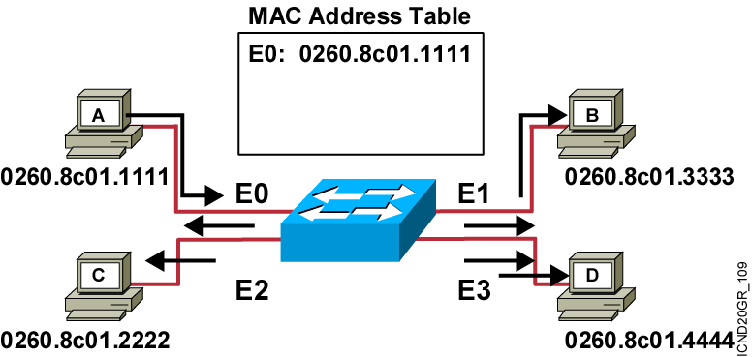
Learning Addresses
Station A sends a frame to station C.
Switch caches the MAC address of station A to port E0 by learning the source address of data frames.
The frame from station A to station C is flooded out to all ports except port E0 (unknown unicasts are flooded).
Notes:
Slide 2 of 3

Slide 10
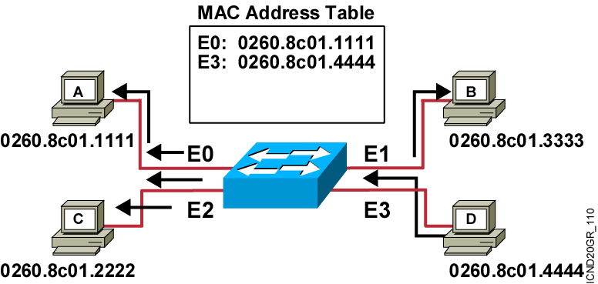
Learning Addresses (Cont.)
Station D sends a frame to station C.
Switch caches the MAC address of station D to port E3 by learning the source address of data frames.
The frame from station D to station C is flooded out to all ports except port E3 (unknown unicasts are flooded).
Notes:
Slide 3 of 3
Emphasize: Once C replies, the switch will also cache station C’s MAC address to port E2, as shown in the next slide.

Slide 11
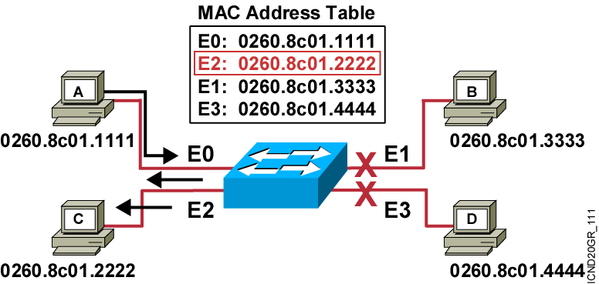
Filtering Frames
Station A sends a frame to station C.
Destination is known; frame is not flooded.

Slide 12
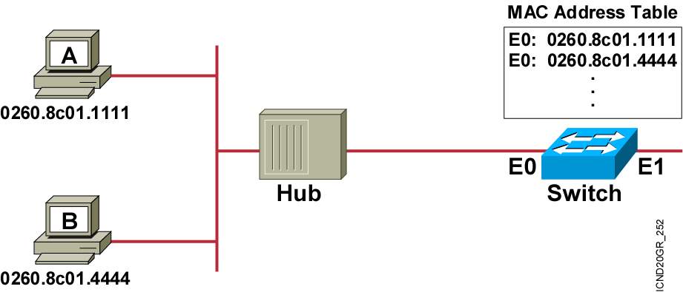
Filtering Frames (Cont.)
Station A sends a frame to station B.
The switch has the address for station B in the MAC address table.

Slide 13
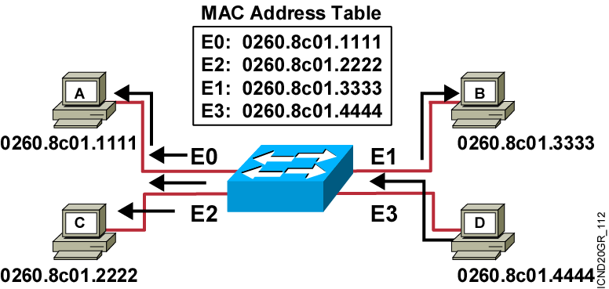
Broadcast and Multicast Frames
Station D sends a broadcast or multicast frame.
Broadcast and multicast frames are flooded to all ports other than the originating port.

Slide 14
Summary
  Ethernet switches and bridges increase the available bandwidth of a network by creating dedicated network segments and interconnecting the segments.
  Switches and bridges use one of three operating modes to transmit frames: store and forward, cut-through, and fragment-free.
  Switches and bridges maintain a MAC address table to store address-to-port mappings so it can determine the locations of connected devices.
  When a frame arrives with a known destination address, it is forwarded only on the specific port connected to the destination station.
Notes:
Purpose: This slide discuss the initial configurations on the routers and switches.
Note: There is no setup mode on the Catalyst 1900 switch.

Slide 15


